Slide 1
Functional Areas Programme
CONSOLIDATION OF ADMINISTRATIVE-TERRITORIAL REFORM :
PRACTICES AND LEARNINGS

Slide 2
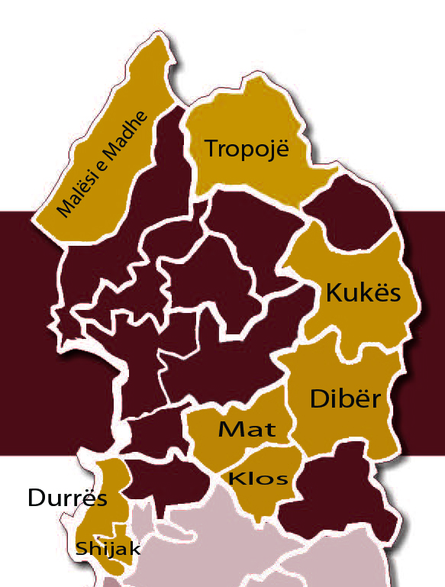
1. Background
8 Functional Areas (FA) selected in the 5 Regions of Northern Albania
Elaboration of 10-15 project ideas for each FA

Slide 3
2. Project characteristics
Financial Volume of the 105 projects (10-17 per FA)
Total fund requirement is 39.1 mio. €
Four projects are bigger than 2 mio. €
Three roads cost 17.8 mio. €
¾ of projects are smaller than 0.3 mio € !
The overall estimated budget requirement for the best ranked project per FA (8) is 2.8 mio. € for the top three projects (24) is 5.4 mio €

Slide 4
Main funders and multi-stakeholder approach

Slide 5
LGU Functions and TAR
Except a few, almost all projects are within the present definition of LGU functions (this includes a better definition of the projects of local economic development).
Waste management and One Stop Shop projects have the biggest potential to support transition and sustainable development.
Project categories
15 of the best rated projects contribute to the implementation of TAR

Slide 6
The best rated projects (24)
1/3 of the best projects are in the environmental sector (mostly waste mgt.)
Most have sectorial cross-cutting character
The top ranked projects are: 5 waste management, 1 afforestation, 1 market place development 1 agro-processing
The ranking gap between the public and technical experts was highest for social and educational projects -> they are not part of the best rated projects

Slide 7
5. Conclusions and Recommendations
The Territorial and Administrative Reform (TAR) provides a unique chance to use such projects in order to
promote economic and social cohesion
provide better public services to more clients
increase efficiency of the LGU administration (economy of scale)
-> the projects with the highest potential to support the reform during the transition and amalgamation of LGUs should be identified and prioritized for funding. FAP provides and instrument for such identification

Slide 8
5. Conclusions and Recommendations
The FAPs and the project fiches are not very clear on cooperation modalities of the stakeholders in PPPs and there is a variety of stake-holders who are supposed to contribute as partners of funders
-> The role of PPP stakeholders should be analyzed further and made more concrete (contributions, contracting issues, etc.): there is a potential to be explored there but capacities are weak;
-> There is a need for clarification of funding schemes and the role of de concentrated agencies in the local development: changes should be initiated accordingly.

Slide 9
5. Conclusions and Recommendations
Co-financing capacities of the LGUs are not specified in the project fiches
-> all costs appear to be looked for from other funding schemes (national, donors etc.). The co-financing issue will need a review and reduces the overall fund requirements but this would highly depend if intergovernmental transfers will be sufficient to support investment and development.

Slide 10
5. Conclusions and Recommendations
4. Many projects in the agro-processing and tourism sector address local economic development and the cooperation with the technical experts of de-concentrated agencies will be important
-> Overlapping functions between LGUs and de-concentrated agencies has to be avoided and clarified

Slide 11
5. Conclusions and Recommendations
5. Almost all projects address existing functions of LGUs
-> The securing of predictable funding to LGUs is more important than adding new functions.
6. The existing fund schemes allocate more than 200 mio. € to investment projects annually. Therefore ample possibilities to fund FAP projects exist (less than 30 mio. €/year).
-> The local stakeholders should lobby with line ministries and strengthen their technical capacities to get access to these funds through mature of projects, such facilitation role should be entitled to a responsible institutions

Slide 12
5. Conclusions and Recommendations
7. The level of unconditional transfers (11.4 mio. for the 8 FAPs) is relatively low compared to the mandatory functions of the LGUs and the investment budgets (13.4 mio)
-> there is a need to increase the pool of unconditional transfers, to revise the allocation criteria and to strengthen control mechanism
8. The challenges regarding the social cohesion in the LGU will remain. There is a risk that some sub-units will not be represented in the new LGU (council).
-> FAPs and their projects must avoid to foster imbalances or social and economic disparities

Slide 13
Functional Areas Program
Thank you!
Programme for Decentralization and Local Development (dldp) www.dldp.al | www.km.dldp.al | dldp@helvetas.org

